Slide 1
Creative Writing Fellowships
NATIONAL ENDOWMENT FOR THE ARTS
Wednesday, February 5, 2014
Notes:
Welcome to the NEA Creative Writing Fellowships Webinar. I’m Amy Stolls, Acting Director of Literature. With me here are Eleanor Steele, our literature specialist, and Rebecca Maner, literature’s division specialist. Thank you for joining us today.
A few housekeeping issues before we begin:
We’ll give a brief PowerPoint presentation and then open the floor to questions.
Note that you are all muted and will only be able to hear us.
You can submit questions/comments at any time using the Q&A box below the PowerPoint. We will do our best to address as many as possible during the time we have.
Please do not use the "raise hand" button.
This webinar will be posted on our website in a few days so you can refer to it in the future. Let’s begin…

Slide 2
NATIONAL ENDOWMENT FOR THE ARTS
Creative Writing Fellowships
Notes:
First, a quick overview of the NEA
We:
are a public agency dedicated to advancing artistic
excellence, creativity, and innovation for the
benefit of individuals and communities.
award grants to arts organizations of all sizes.
across all 50 states and 6 U.S. territories.
Our goals:
To support the creation of art that meets the highest standards of excellence
To engage the public with diverse and excellent art
To promote public knowledge and understanding about the contributions of the arts

Slide 3
PROGRAM OVERVIEW
ELIGIBILITY REQUIREMENTS
APPLICATION
PROCESS
QUESTIONS?
Notes:
Hi, everyone. Thanks for joining us.
Today, we’re going to give you an overview of the Creative Writing Fellowships Program and focus on eligibility requirements as well as the logistics of the application process.
As I mentioned earlier, we’ve also saved time for questions.
Two things before we begin:
We care deeply about writers. The NEA Literature Staff respects the work you do, and we are happy to help throughout the application process.
Don’t wait until the day of the deadline.

Slide 4
PROGRAM OVERVIEW
Notes:
NEA Literature Fellowships are grants offered to published creative writers that enable the recipients to set aside time for writing, research, travel, and general career advancement. Grants are not awarded for specific projects—they are designed to give fellows the time and means to write.

Slide 5
Fellowships
Literature Fellowships are the NEA’s only
direct awards available to writers.
PROGRAM OVERVIEW
Notes:
Literature Fellowships are the NEA’s only direct awards available to writers. We are proud of these fellowships and grateful that the NEA can continue to directly support individual writers.

Slide 6
$25,000 grants
Prose and poetry fellowships available in alternating years.
Late February or Early March deadline. This year the deadline for poetry is March 12, 2014.
Manuscripts are reviewed anonymously.
Most competitive funding category at the NEA.
PROGRAM OVERVIEW
Notes:
Fellowship grants are $25,000 each.
Prose and poetry fellowships are available in alternating years. This year, Fellowships in Poetry are available.
The deadline usually falls in late February or early March. This year our deadline is March 12, 2014.
Manuscripts are reviewed anonymously. The panel only sees your manuscript.
Fellowships are the most competitive funding category at the NEA.

Slide 7
FY 2013 Poetry | 40 Fellowships Awarded
Notes:
We received 1,137 eligible applications in poetry in fiscal year 2013 and awarded 40 fellowships.

Slide 8
FY 2014 Prose| 38 Fellowships Awarded
Notes:
In FY 2014, we received 1, 316 eligible applications and funded 38 fellowships. The prose application pool is usually a bit larger than poetry.

Slide 9
Award Winners
Since 1990, NEA Fellows have won:
33 Pulitzer Prizes
27 National Book Critics Circle Awards
27 National Book Awards
PROGRAM OVERVIEW
Notes:
NEA Fellowships have a proven track record of identifying and supporting new talent.
Since 1990, NEA Fellows have won:
33 Pulitzer Prizes
27 National Book Critics Circle Awards and
27 National Book Awards
Most of these winners received an NEA Literature Fellowships before any major national award, usually at least a decade earlier.

Slide 10
Louise Erdrich
NEA 1983
National Book Award 2012
Edward P. Jones
NEA 1986
National Book
Critics Circle Award 2003
Pulitzer Prize 2004
Jeffrey Eugenides
NEA 1995
Pulitzer Prize 2003

Slide 11
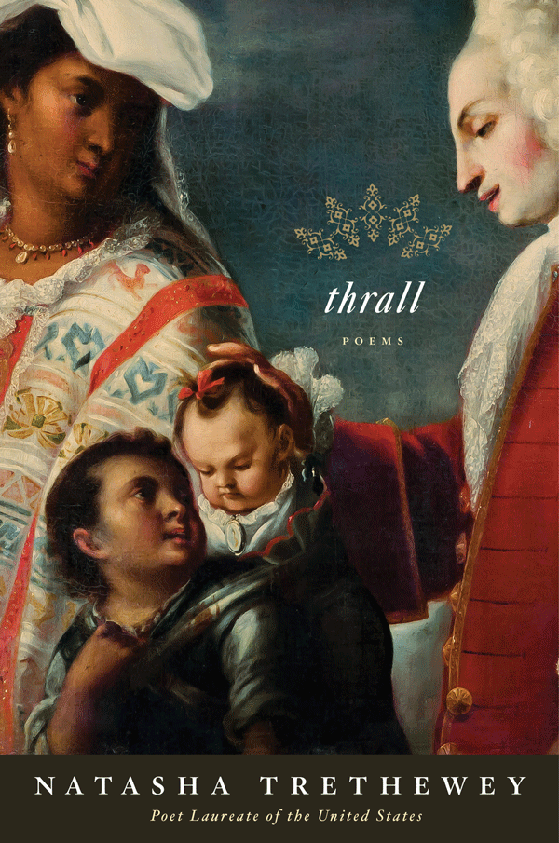
Philip Levine
NEA 1976, 1981, 1987
Poet Laureate
2011-2012
Natasha Trethewey
NEA 1999
Poet Laureate
2012-Present
Notes:
Nine of the last ten U.S. Poets Laureate are NEA Fellows.
Here are two examples, Philip Levine and Natasha Trethewey .

Slide 12
FY 2013 NEA POETRY FELLOWS
Jose Perez Beduya • Miriam Bird Greenberg • Elizabeth Hughey • Traci Brimhall • Jenny Browne • Suzanne Buffam • Ken Chen • Maxine Chernoff •Eduardo C. Corral •Lisa Fay Coutley • Meg Day • Ansel Elkins • Jill Alexander Essbaum • Reginald L. Flood • Sarah Gorham Pamela Hart • Sy Hoahwah • Joshua Kryah • Sarah Mangold • Kerrin McCadden • Shane McCrae • Rickey Laurentiis • Philip Metres • Simone Muench • John Murillo • Jacob Rakovan • Srikanth Reddy • Roger W. Reeves • James Richardson • Rachel Richardson • David Rigsbee • Atsuro Riley • Sarah Blake • Allison Seay • Solmaz Sharif • B.T. Shaw • Ryan Teitman • Sarah Vap • Jake Adam York • Rachel Zucker
Notes:
Here you will see the list of the fiscal year 2013 NEA Poetry Fellows.
We wanted to show this slide to remind everyone that the NEA fellowships fund writers at all stages of their career—at the time of their award, some of these poets had several books published while others had one or none at all.
If you’re eligible, we encourage you to apply.
Now, I’d like to hand the presentation over to my colleague, Eleanor Steele.

Slide 13
ELIGIBILITY REQUIREMENTS
Notes:
Let’s dive into the details surrounding the application process and most importantly, eligibility.

Slide 14
Eligibility
Take the time to read the fine print.
Notes:
Guidelines regarding eligibility are available on the NEA’s website, arts.gov.
Please take time to read them in their entirety—if you do that first, it will save you time later.

Slide 15
Basic Requirements
Must be a U.S. Citizen or a Permanent Resident.
One application per year.
Must be a published creative writer.
Must meet publication eligibility requirements.
Notes:
Here are the basic eligibility requirements:
You must be a U.S. Citizen or a Permanent Resident.
You may only submit one application per year.
You must be a published creative writer.
You must meet publication eligibility requirements.

Slide 16
Poetry
A volume of 48 or more pages of poetry; or
Twenty or more different poems or pages of poetry in five or more literary journals, anthologies, or publications which regularly include poetry as a portion of their format.
Notes:
To establish your eligibility in poetry, you must have published a volume of 48 or more pages of poetry; or
Twenty or more different poems or pages of poetry in five or more literary journals, anthologies, or publications which regularly include poetry as a portion of their format.
For the upcoming poetry application cycle, the work must be published between January 1,2007 and March 12, 2014.
Up to 16 poems may be in a single volume of poetry of fewer than 48 pages. This volume, however, may count as only one of the required five places of publication. For online publications, a page of poetry is considered to be twenty lines or less.

Slide 17
What Won’t Establish Eligibility
Pre-publication material
Work that has appeared in a publication for which you are the editor, publisher, or staff
Collaborative work
Scholarly writing
Instructional writing
Journalism
Book reviews
Editorials/letters to the editor
Interviews
Student publications
ELIGIBILITY REQUIREMENTS
Notes:
Here is the material that cannot be used to establish eligibility:
Pre publication material such as galleys, proofs, and advance reader's copies. We use the publishers date of publication in order to determine when a work was officially published.
Work that has appeared in a publication for which you are the editor, publisher, or staff.
Collaborative work.
Scholarly writing.
Instructional writing.
Journalism.
Book reviews.
Editorials/letters to the editor.
Interviews.
Student publications—publications that primarily print work by persons who are affiliated with a particular academic institution.

Slide 18
What Won’t Establish Eligibility
Any publications by presses or journals that:
Require individual writers to pay for part or all of the production costs;
Require writers to buy or sell copies of the publication;
Publish work without competitive selection or a stated editorial policy;
Publish work without professional editing.
Notes:
Any publications by presses or journals that:
Require individual writers to pay for part or all of the production costs;
Require writers to buy or sell copies of the publication;
Publish work without competitive selection or a stated editorial policy;
Publish work without professional editing.
We are aware that the publishing world is changing rapidly for writers and readers alike. However, at this time, these are the publication requirements for both prose and poetry, but they are revisited and revised every summer. All to say, these requirements may be altered in the future, but they stand for now.

Slide 19
APPLICATION PROCESS
Notes:
Now on to the application process.

Slide 20
The Application Process
All applications must be submitted through www.Grants.gov.
APPLICATION PROCESS
Notes:
All applications must be submitted through Grants.gov. The NEA does not accept paper applications.
So, what is Grants.gov?
Grants.gov is the federal government's online application system. It provides one central portal where organizations and individuals can electronically find and apply for grants throughout the federal government.
Grants.gov is THE single access point for over 1,000 grant programs offered by the 26 federal agencies that make grants.
The Grants.gov system is not customized for NEA creative writing fellowship applications. Also note that Grants.gov and the NEA are not the same agency.

Slide 21
Step One: Find and Review Guidelines
Visit the NEA website at www.arts.gov.
APPLICATION PROCESS
Application Process
Notes:
The first step in the application process is finding and reviewing the guidelines. The guidelines are available on the NEA’s website at arts.gov.

Slide 22
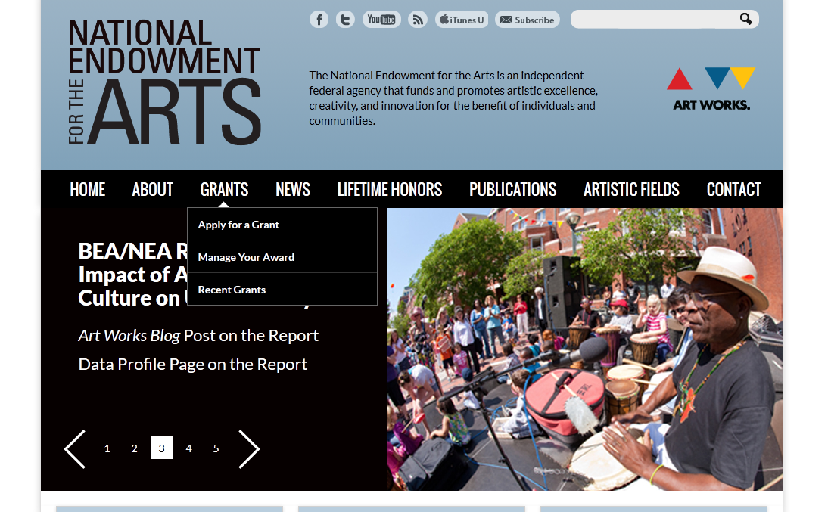
Applying to Art Works
Find our guidelines
online at:
arts.gov in the
“Apply for a Grant”
section
Notes:
To locate the guidelines for fellowships applications, find the “Grants” tab on our homepage and select the “Apply for a Grant” option.

Slide 23
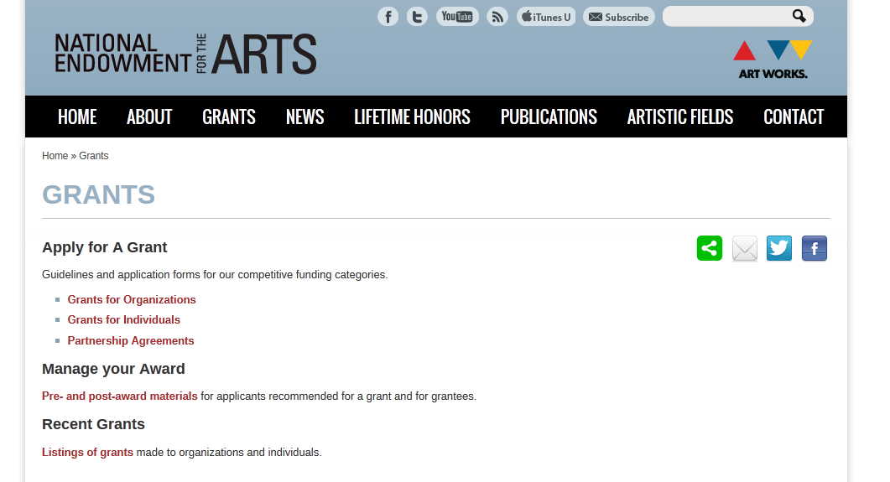
Select a
Discipline
Notes:
Under the “Apply for a Grant section,” choose the “Grants to Individuals “option.

Slide 24
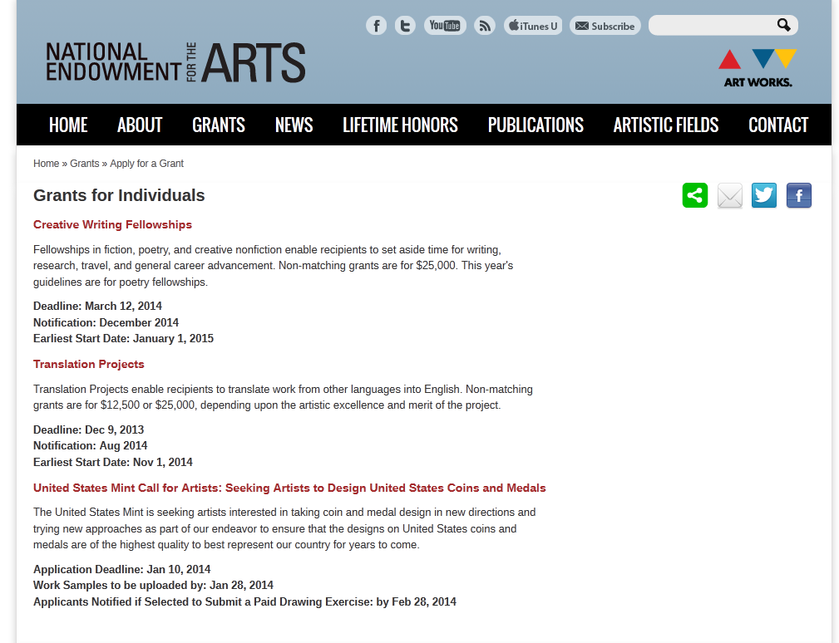
Notes:
Next, click on Creative Writing Fellowships, and that will bring you to the guidelines homepage.

Slide 25
Step Two: Register and Download
Register with www.Grants.gov.
Download the application package.
APPLICATION PROCESS
Application Process
Notes:
After reading the guidelines carefully, your next step should be registering with Grants.gov and downloading the application package.

Slide 26
Register with Grants.gov
Notes:
Registration with Grants.gov is a one time process which can take up to a day to complete. Under the applicants tab on the Grants.gov homepage, you will choose to register as an individual.
Remember your Username and password. Maybe even stick it to your refrigerator with a magnet. When it’s time to submit your application, you’ll need that information again.

Slide 27
Download Application Package
Notes:
Under the “Search Grants” tab on the Grants.gov homepage, you will download the application package. To download the application package you will need the funding opportunity number, which can be found in the guidelines on the NEA’s website.
You can also use the hyperlink on our website under the “Download the Application Package” section of the guidelines and it will take you directly to the funding opportunity listing at Grants.gov.

Slide 28
Download Application Package
Notes:
Once downloaded, your application package will be in the form of a PDF, and will look like the screenshot up on the slide.
Remember to save your downloaded application package to your desktop or somewhere easy to locate on your network. As you work on the application, you must routinely save your work in order not to lose anything. You are not working in the cloud.

Slide 29
Step Three: Prepare and Submit Your Application
Notes:
Now, that your application package is downloaded and saved on your desktop or network, you will follow the step-by-step instructions in the How to Prepare and Submit an Application section of the NEA guidelines for Creative Writing Fellowships.
We recommend that you keep this section of the guidelines open on your computer as you work through the Grants.gov application package.
After completing your application, you will submit it via www.Grants.gov.

Slide 30
Mandatory Documents
A complete application consists of:
Application for Federal Assistance
(SF-424 Individual Form)
Attachments Form to which you have attached:
Literature Fellowships Application Supplemental Information Form
Manuscript
Cover page
Summary of applicant publications
Notes:
Before it is submitted though, you must make sure that it is complete.
A complete application consists of an SF-424 Individual form, and an Attachments Form to which you have attached:
Literature Fellowships Application Supplemental Information Form
Manuscript
Cover page
Summary of applicant publications

Slide 31
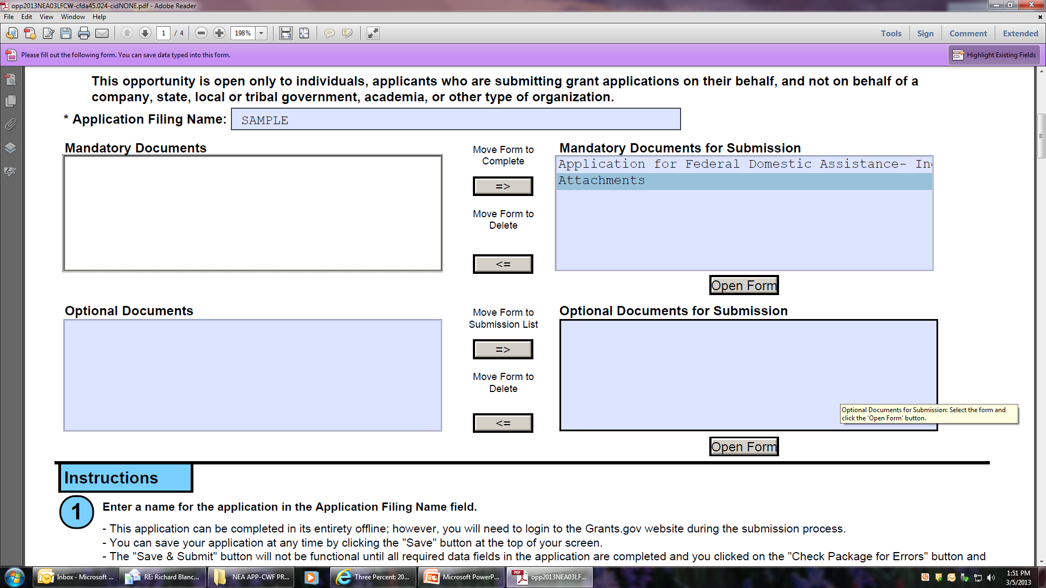
Mandatory Documents, Cont.
Notes:
The Grants.gov application package requires that you select forms to complete. This mean that you’ll need to move the mandatory documents that I reference on the previous slide from the box on the left to the box on the right so that they appear in succession as a part of the package.

Slide 32
SF-424 Individual Form
Notes:
Let’s go over the mandatory documents one by one. This is what your SF-424 Individual Form will look like. The form asks you for basic information like your name and address. The NEA guidelines provide detailed instructions on how to complete each field in this form.

Slide 33
Attachments Form
Notes:
This is what the attachments form will look like. This is the area of your application where you will add the other mandatory documents . Adding a document to this form is much like attaching a document to an e-mail. You will only have four attachments for this application package.

Slide 34
Required Attachments:
Supplemental Information Form
Available for download on NEA website, not Grants.gov.
Manuscript Sample
Created by applicant and uploaded to Grants.gov application package. (Only attachment reviewed by panel.)
Cover Page
Created by applicant and uploaded to Grants.gov application package.
Summary of Applicant Publications
Created by applicant and uploaded to Grants.gov application package.
Notes:
Let’s review what those required attachments are.
Number one is the supplemental information form. This form is available for download from the NEA’s website. You cannot find this form on Grants.gov.
Number two is your manuscript sample. This attachment is created by the applicant, and it is the only attachment reviewed by readers and panelists.
Number three is your cover page. This attachment is created by the applicant.
Number four is your summary of applicant publications. This attachment allows us to verify your publication history and eligibility. It is created by the applicant.
All attachments should be uploaded as PDFs. We have detailed information about how to convert documents to a PDF in our guidelines.
Our guidelines also have specific information about what is included in each required attachment.
Once your application is complete, the most important component of it is the manuscript.

Slide 35
Manuscript sample must be:
From work that you have written in the time period that establishes your eligibility, and for which you have sole artistic responsibility.
In the literary genre in which you establish your eligibility.
Completely free of your name, initials, address, or any other marks that could identify you.
Labeled to indicate title and genre of the sample.
In typescript and clearly readable.
Notes:
From work that you have written in the time period that establishes your eligibility, and for which you have sole artistic responsibility. You may submit published work, unpublished work, or work in progress. Do not indicate whether or not the material has been published.
In the literary genre in which you establish your eligibility. So if you’re applying for poetry, you mss sample must be poetry.
Completely free of your name, initials, address, or any other marks that could identify you.
Labeled to indicate title and genre of the sample. At the top of every page, include the page number in the upper right corner and state the title of the manuscript. If the manuscript does not have title, you may list the title of the poem or excerpt or simply not include a title.
In typescript and clearly readable. Use a 12 point font and margins of at least one inch at the top, bottom, and sides of all pages. Do not submit more than the maximum number of pages that are allowed; excess pages will be removed.
You may submit up to 10 pages of poetry, and up to 25 pages of prose.
Reminder: this is an anonymous process and these are not project based awards. Awards are given based solely on the artistic excellence of the manuscript submitted. Please submit your best work.

Slide 36
Helpful Reminders & Tips
Read the Guidelines in their entirety.
Visit the “Need Help” section of the Guidelines.
The Summary of Applicant Publications is not a resume.
If you use a Mac, don’t use Safari.
Don’t create PDFs by scanning.
Don’t begin the day of the deadline.
Application Process
Notes:
Read the Guidelines in their entirety. Doing this first will save you time later.
Visit the “Need Help” section of the guidelines. This section includes several FAQs addressing a range of topics: from how to create a PDF to issues of eligibility to allowable costs to formatting your zip code. Please consult this section before e-mailing or calling the NEA.
The Summary of Applicant Publications is not a resume.
Don’t get bogged down listing everything you’ve ever published on your summary of application publications. Those attachments are for staff use only. The panel will only review your manuscript.
If you use a Mac, don’t use Safari.
Applicants using a Mac have had luck with Mozilla Firefox. Also, Mac Users make sure you are using Adobe Reader to view PDFs, not Preview.
Don’t create PDFs of your documents by scanning—this results in very low quality (and rather large) attachments that are difficult for our staff and panelists to read.
Don’t begin your application the day before or the day of the deadline—nine times out of ten, this results in a great deal of stress on the applicant and often means that you miss the deadline. Even if you submit the application 5 sec. after 11:59pm EST, your application will not be accepted. There are NO exceptions to this rule.

Slide 37
When to contact NEA v. Grants.gov
Contact Grants.gov helpline (800-518-4726)for computer/technical issues.
Contact NEA Literature staff (litfellowships@arts.gov)for
questions about the
Guidelines.
APPLICATION PROCESS
Notes:
If you’ve visited the “Need Help” section of our website, and still need to talk with someone about your question, you can contact the NEA or the Grants.gov help line. Grants.gov can assist you with technical concerns like downloading your application package, registering as an individual, and/or uploading the application package.
The NEA can help with questions about our guidelines, specifically eligibility and/or the contents of your attachments.

Slide 38
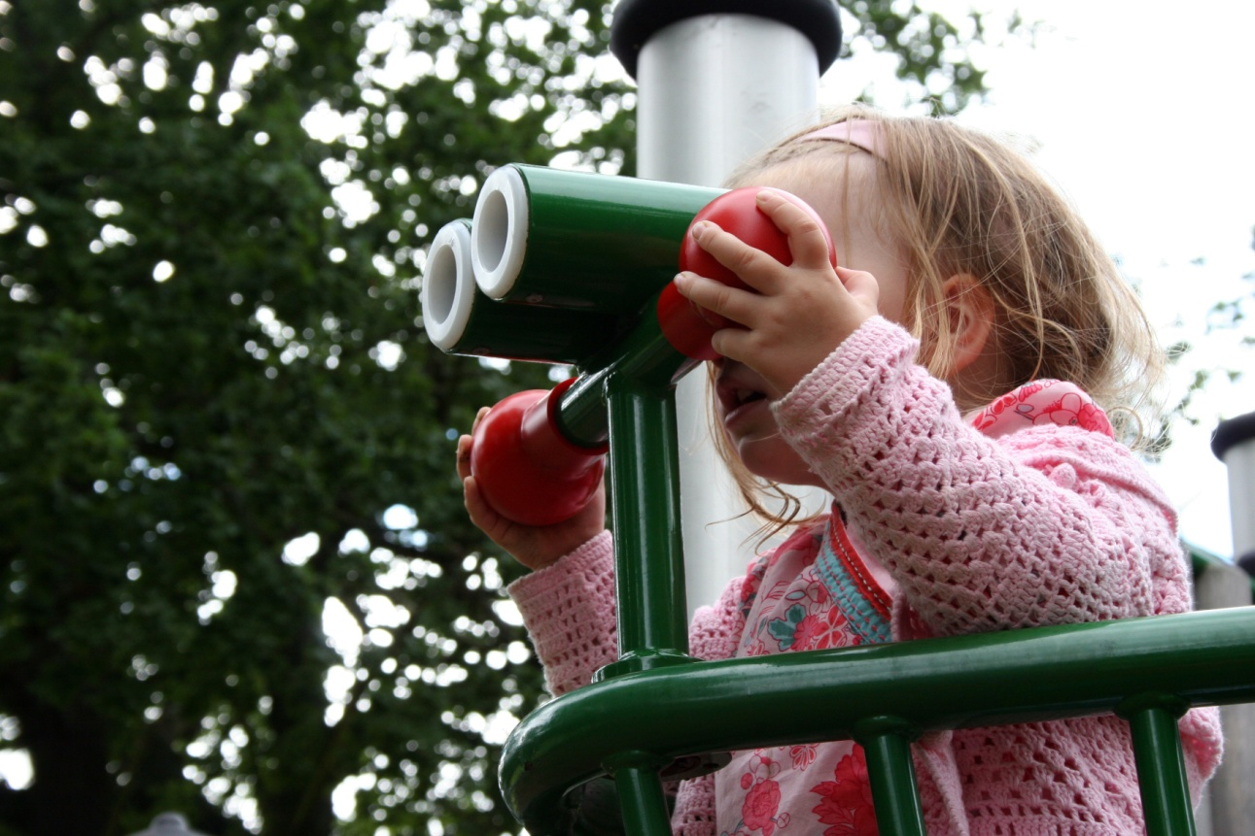
The Review Process
A quick peek behind the scenes.
Application Process
Notes:
Let’s talk briefly about what happens to your application after you successfully submit through Grants.gov.

Slide 39
The Review Process
Each eligible manuscript is read by three readers.
Panelists discuss the manuscripts and make recommendations for funding.
Recommended applications are sent to the National Council on the Arts.
NEA Chairman reviews the Council’s recommendations and makes the final decision on all grant awards.
Notes:
Each eligible manuscript is read by three first-round readers who submit comments and recommendations to a panel of judges.
Panelists discuss the manuscripts and make recommendations for funding.
Recommended applications are sent to the National Council on the Arts.
The Council votes to approve or disapprove the panel’s recommendations.
Finally, the NEA Chairman reviews the Council’s recommendations and makes the final decision on all grant awards.

Slide 40
NEA Readers and Panelists
Represent a diverse range of:
Aesthetic taste
Age
Ethnicity and race
Gender
Geography
Notes:
NEA readers and panelist represent a diverse range of:
-aesthetic taste
-age
-ethnicity and race
-gender, and
-geography
You can find the names of past panelists online at arts.gov.

Slide 41
Timeline – remember to think head
Timeline | Poetry FY 2015
Application
Deadline
March
2014
Panel Review
September
2014
Council Approval
October
2014
Award Notification
December
2014
Project
Start
January 1,
2015
Notes:
It takes a long time to process your NEA application, and here’s why…

Slide 42
Notification Process
E-mail notifications go out to all applicants around Thanksgiving.
If you change your email address during the year, please email us at litfellowships@arts.gov to update your file.
Notes:
E-mail notifications go out to all applicants around Thanksgiving.
We no longer send hard copy letters of notification.
If you do apply for an NEA Fellowship, remember to check your junk mail box in late November or early December to see if you missed an e-mail from us.
If you change your email address during the year, please email us at litfellowships@arts.gov to update your file.

Slide 43
Writers’ Corner
Meet our Fellows and read excerpts from their winning manuscripts at www.arts.gov
Notes:
If you are curious about what type of work the NEA is funding, please take time to visit the Writers’ Corner feature on our website. On the Writers’ Corner page, you can review excerpts from winning manuscripts and learn more about recent fellows.

Slide 44
NEA Contact
E-mail
Litfellowships@arts.gov
Fellowships Hotline
202.682.5034
QUESTIONS?
QUESTIONS?
Notes:
Here is our contact information. The hotline and the litfellowhips inbox will reach us directly. As we mentioned earlier, please contact the NEA only after consulting the “Need Help” section of the guidelines.
That is the end of our formal presentation, but we’re happy to answer questions.

Slide 45
QUESTIONS?
Notes:
Thank you for joining us, and remember that this webinar will be archived on the NEA’s website. The archive should be available in about four to five business days. Goodbye!

