Slide 1
The Psychology of Creativity
Dr. James C. Kaufman
Professor of Educational Psychology
Neag School of Education
University of Connecticut
Notes:
1

Slide 2
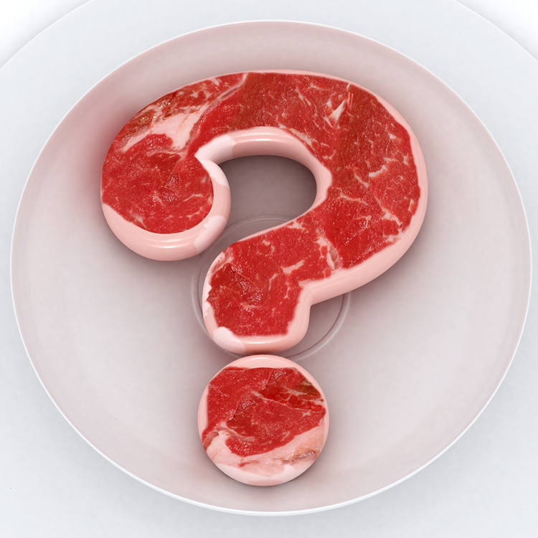
What is Creativity?
Notes:
2

Slide 3
What is Creativity?
Consider…..
Once Upon a Time
Notes:
3

Slide 4
What is Creativity?
Is that creative? Most would say no.
Creativity typically needs to be something…
Novel New Original
Different Innovative
Unique
Notes:
4
What is this a picture of?

Slide 5
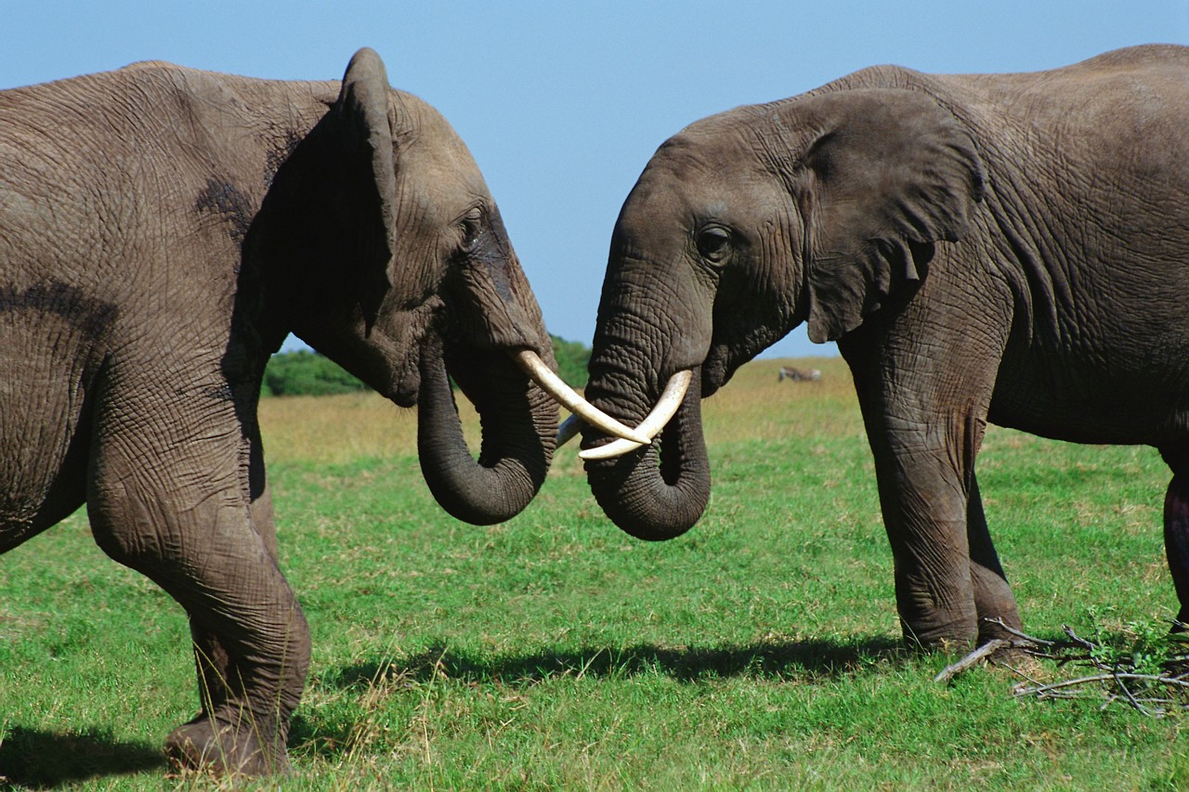
What is Creativity?
Notes:
5

Slide 6

What is Creativity?
Is that creative?
Most creativity
researchers would
say no.
Why?
Notes:
6
What is this a picture of?

Slide 7
What is Creativity?
The ability to produce work that is
BOTH
novel
(i.e., original, unexpected)
AND
appropriate
(i.e., useful, adaptive)
novel
appropriate
Notes:
7

Slide 8
What is Creativity?
Another way to think about creativity is the Four P’s:
Person
Process
Product
Press
Notes:
8

Slide 9
What is Creativity?
Person
Notes:
9

Slide 10
What is Creativity?
Process
Notes:
10

Slide 11


What is Creativity?
Product
Notes:
11

Slide 12

What is Creativity?
Press
Notes:
12

Slide 13
What is Creativity?
Or you could consider the Four C’s:
mini-c
little-c
Pro-c
Big-C
4C’s
Notes:
13

Slide 14
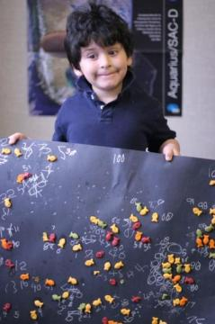
What is Creativity?
mini-c
Notes:
14

Slide 15

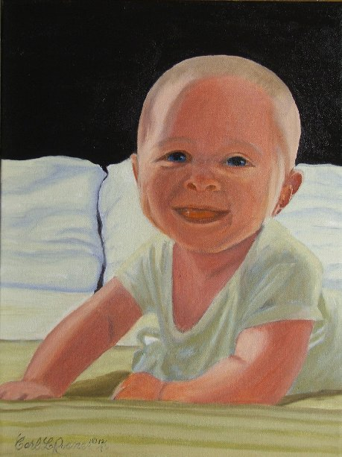
What is Creativity?
little-c
Notes:
15

Slide 16
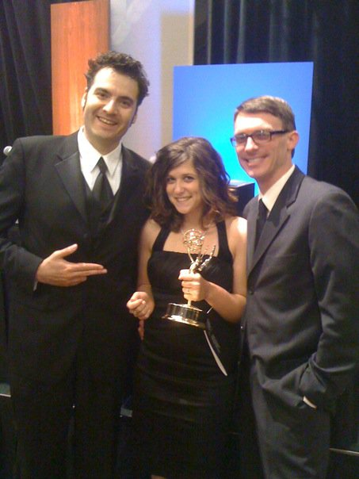
What is Creativity?
Pro-c
Notes:
16

Slide 17
What is Creativity?
Big-C
Notes:
17

Slide 18
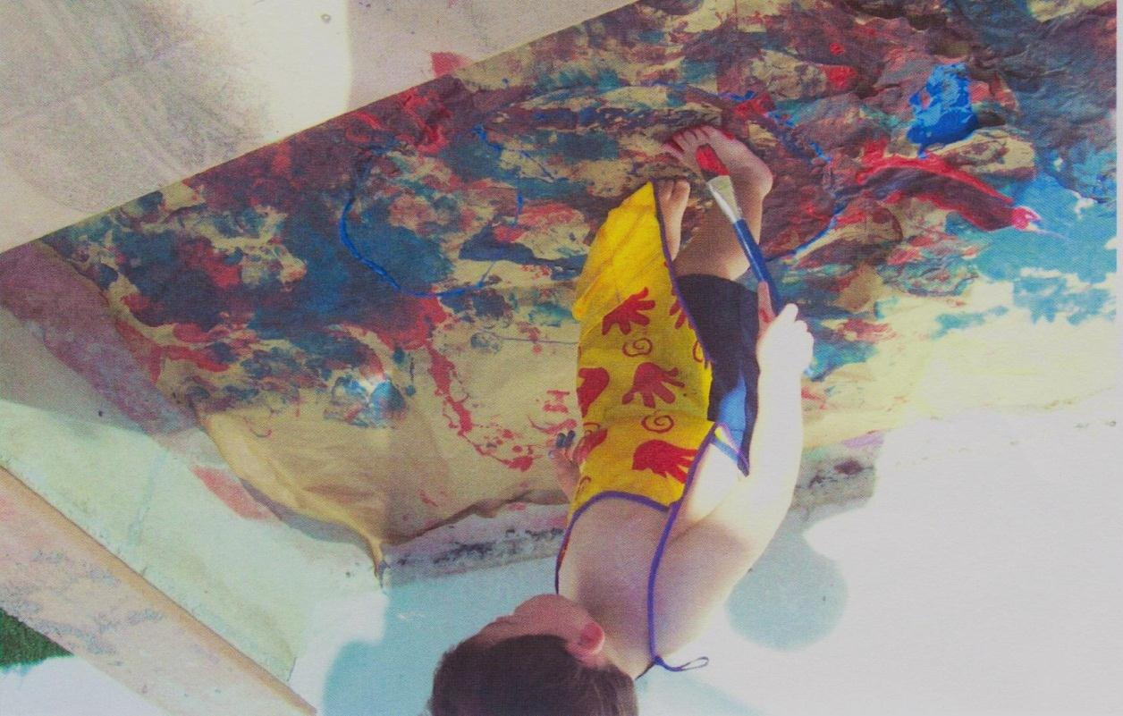
What is Creativity?
You can be creative in many domains
Not just art
Notes:
18

Slide 19

What is Creativity?
There are many measures of creativity.
Notes:
19

Slide 20
What is Creativity?
Some look at divergent thinking
(having many ideas)
idea
idea
idea
idea
idea
idea
idea
Notes:
20

Slide 21

What is Creativity?
How many uses can you think of for a brick?

Slide 22
What is Creativity?
Fluency – how many ideas you have
Flexibility – how many categories you use
Originality – how rare your ideas are

Slide 23
What is Creativity?
Association Theory = More Creative,
More Remote Associations

Slide 24
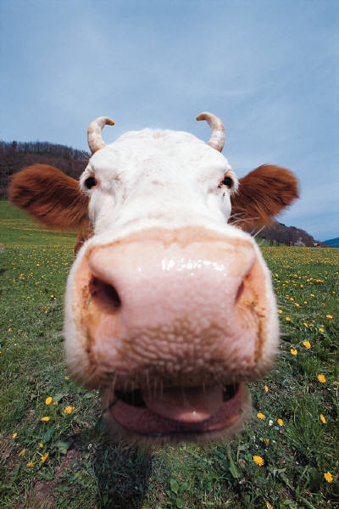
What is Creativity?
Cow!
Grass. Cud. Milk. Burgers. Cheese. Goats. Cheddar.
Holy Cow. Don’t have a cow.
Bart Simpson.

Slide 25
What is Creativity?
SLEEPING BEAN TRASH ________________

Slide 26
What is Creativity?
SLEEPING BEAN TRASH ________________
BAG

Slide 27
What is Creativity?
Sometimes creative products are rated by qualified experts.
Notes:
27

Slide 28
What is Creativity?
These experts might be poets, scientists, teachers, graduate students, peers, or the creator.
Notes:
28

Slide 29
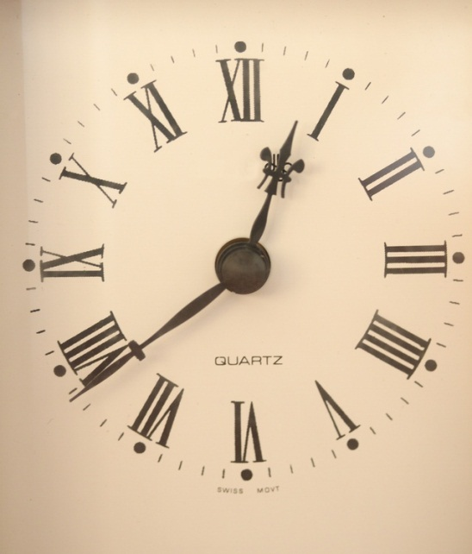

Why Creativity?
Creativity uses a lot of resources
Time Money Effort
Notes:
29

Slide 30
Why is creativity?
Businesses and organizations focus on creativity.
Why?
- Innovation is a driving
force behind today’s
global market.
- Science has shown that
people prefer products
that are more creative.
- Companies with a “pro-creativity” attitude are more likely to have financial breakthroughs.

Slide 31
Why creativity?
Creative people…
Get promoted more.
Earn higher salaries.
Are more successful entrepreneurs.
Are more satisfied in their careers.

Slide 32
Why creativity?
People who are creative are more likely to …
Be in better physical health
Have a higher state of general well-being
Be more resilient
Have less personal
stress
- Be in better moods

Slide 33

Creativity Tips
So what can we do to be more creative?
Inspiration is
overrated.
Notes:
33

Slide 34

Creativity Tips
Creativity is directly connected with domain-knowledge, expertise, and persistence.
Notes:
34

Slide 35
Creativity Tips
Emphasize that creativity, like intelligence, is malleable, not fixed.
Its stretchy

Slide 36
Creativity Tips
Creative people tend to be high on a personality
factor called Openness to Experience.
This represents your intellectual and
experiential
curiosity.

Slide 37


Creativity Tips
Openness to Experience can mean…
Trying new things

Slide 38


Creativity Tips
Openness to Experience can mean…
Liking intellectual challenges

Slide 39
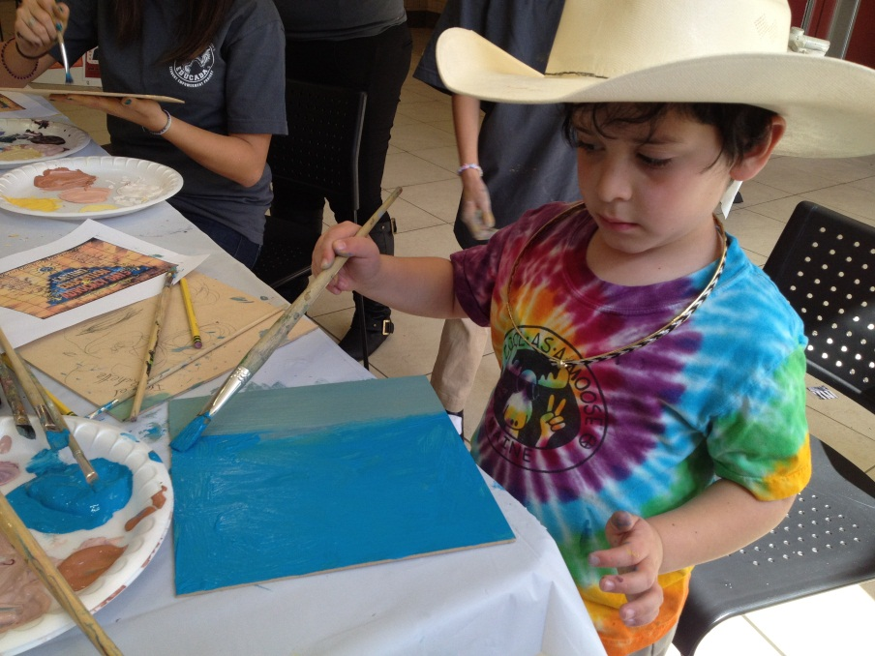
Creativity Tips
Openness to Experience can mean…
Using your imagination.

Slide 40
Creativity Tips
Openness to Experience is highly linked to creativity regardless of domain, type of measurement, or ability level.

Slide 41
Creativity Tips
Developing a broader understanding about creativity can help:
Levels of creativity
Scope of creativity

Slide 42
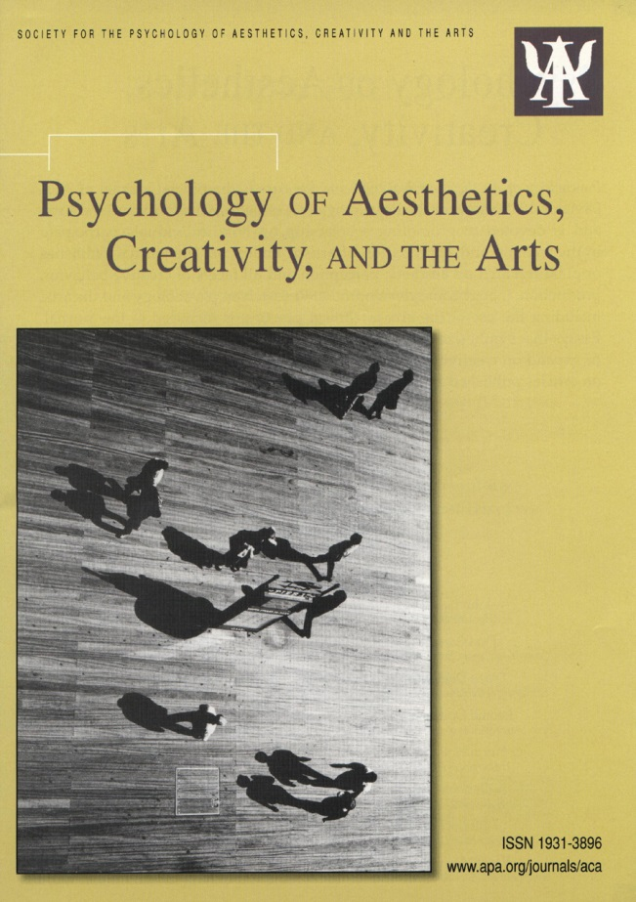
Creativity Tips
The American Psychological Association’s Division 10 (Society for Psychology of Aesthetics, Creativity, and the Arts) is a great way to get involved and stay on top of the current research.

Slide 43

Creativity Tips
Another thing is to think about the role of motivation.
People are more creative
when they are
personally
interested.
Notes:
43

Slide 44
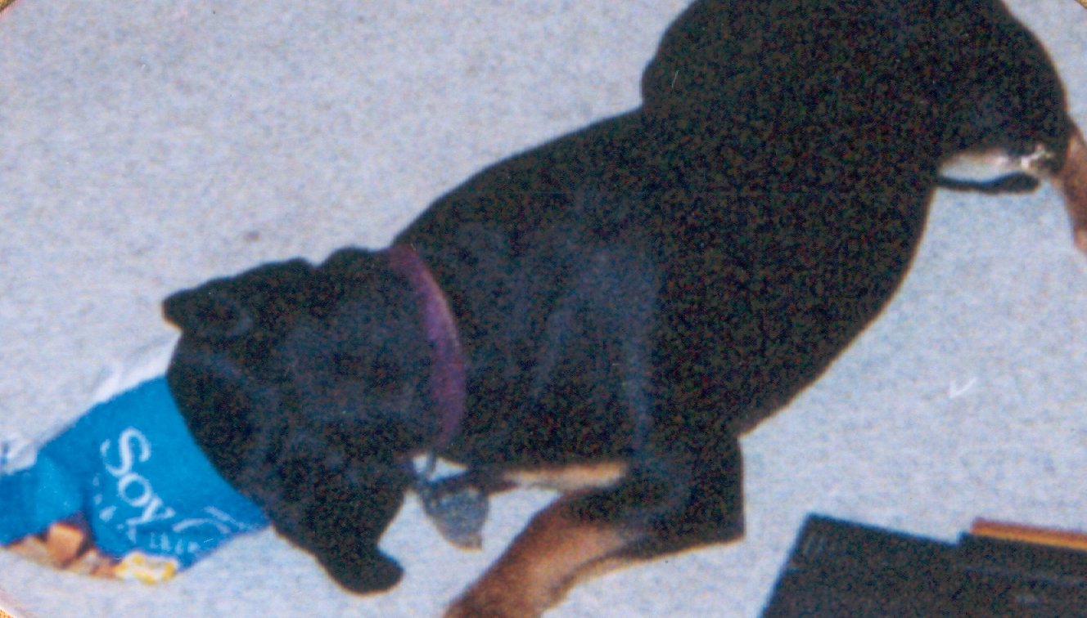
Creativity Tips
Rewards can reduce intrinsic motivation.
Notes:
44

Slide 45
Creativity Tips
Passion = More Creativity
Love what you do.
Notes:
45

Slide 46
Creativity Tips
Consider, finally, creative meta-cognition. People
need to know when to be creative and how
creative they are.

Slide 47
Creativity Tips
Sometimes that means learning how to be
creative.
Sometimes that means learning how to wait for
the appropriate time to share their creativity.

Slide 48
Creativity Tips
We’re used to thinking about nurturing creativity being like Bruce Wayne becoming Batman.

Slide 49
Creativity Tips
But, it’s also useful to think of Superman – who had to become Clark Kent to be effective.

Slide 50
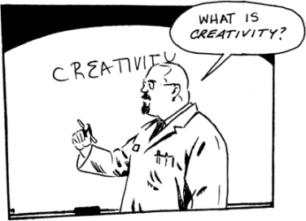
For More Information
James C. Kaufman
Professor of Educational Psychology
University of Connecticut
Neag School of Education
2131 Hillside Road
Storrs, CT 06269-3007
james.kaufman@uconn.edu
http://www.jamesckaufman.com
http://epsy.education.uconn.edu/
Twitter: @jameskaufman
Notes:
50

