Slide 1
NEA’s latest research -- breaking down the data for State Arts Agencies and Regional Arts Organizations
Wednesday, March 4, 2015, 3:00 p.m. - 4:00 p.m. EST

Slide 2
Today’s presenters
Laura Scanlan
NEA Director of State and
Regional Partnerships
Sunil Iyengar
NEA Director of Research & Analysis

Slide 3
Arts Participation and Production: What, Who, Why, and How Much?
Sunil Iyengar
Director, Research & Analysis
National Endowment for the Arts
March 4, 2015

Slide 4
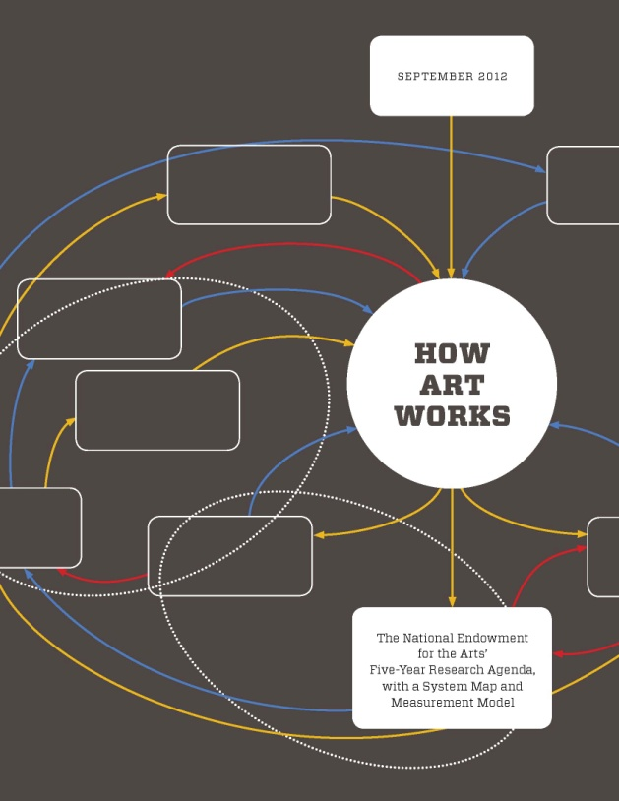
NEA Strategic Plan for Research
Goal: Promote Public Knowledge and Understanding about the Contributions of the Arts
4

Slide 5
President’s Budget for FY 2016
From OMB Analytical Perspectives
“[N]ew modes of cultural engagement have emerged, such as consumption of entertainment and new kinds of media via the internet and electronic devices.....”
5

Slide 6
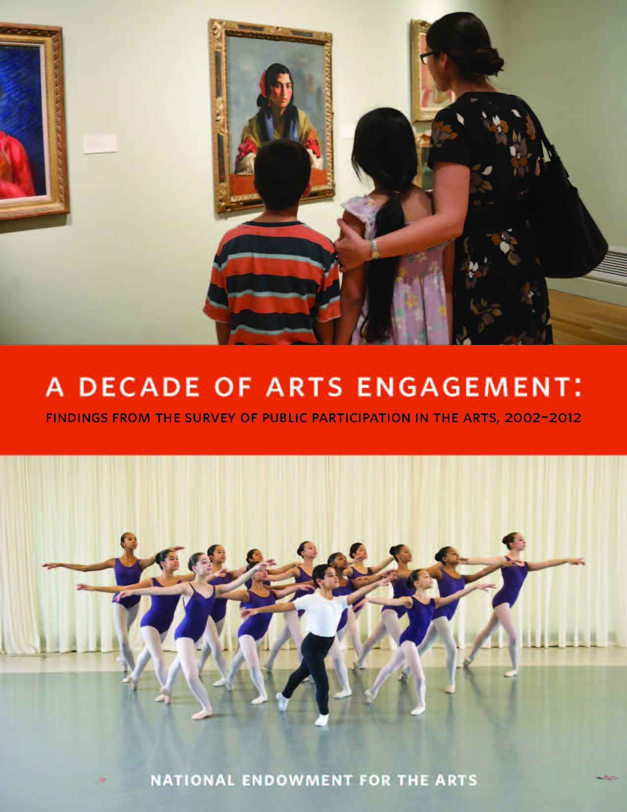
NEA’s Survey of Public Participation in the Arts
6

Slide 7
SPPA: Historical Narrative
Percent of U.S. Adults Who Attended at Least One “Benchmark” Arts Event
0
10
20
30
40
50
7

Slide 8
Percent of U.S. Adults Who…
Used electronic media to view or listen to art
Went to the movies
Read books or literature
Attended any live visual or performing arts
Used electronic media to email, post, or share art
Created, practiced, performed, or edited/remixed art
0
10
20
30
40
50
60
70
80
8

Slide 9
Technology Enables Arts Creation
Among adults who created visual art and/or music in 2012,
the percent who used electronic media
Visual Art | Music
45.6% | 28.4%
38.3% | 41.5%
49.7% | 24.9%
66.0% | 48.1%
49.3% | 13.6%
Overall
Hispanic
White
African American
Other races/ethnicities
9

Slide 10
Percent of U.S. Adults Who Reported Ever Taking an Arts Class or Lesson: 2002/2012
10

Slide 11
Percent of Young Adults (18-24) Who Reported Ever Taking an Arts Class or Lesson: 2002/2012
Music
Visual art
Creative writing
Art appreciation or history
Music appreciation
11

Slide 12
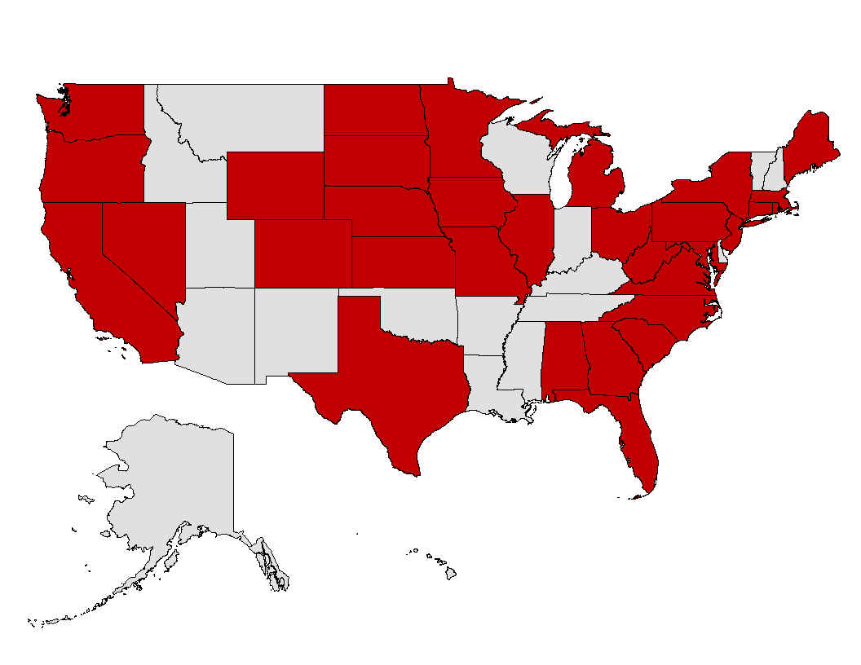
U.S. Regional/State Estimates of Arts Participation Rates
The SPPA provides reliable estimates for 32 states and 11 metro areas
12

Slide 13
Selected Regional Findings: Arts Attendance
New England, Pacific, Mountain regions show highest overall rates
East North Central: more likely than most to attend at elementary/high schools
West North Central, with East North Central, Mountain, and Pacific: more likely to attend parks/outdoors
Although metro residence was linked with higher overall attendance, craft fairs were attended by metro and non-metro residents at equal rates

Slide 14
Selected Regional Findings: Arts Creation
Fiber arts creation most popular in West North Central, New England, and Mountain regions
Leatherwork, metalwork, woodwork: East South Central and West North Central
Non-metro residents generally did these activities at least as much as metro residents

Slide 15
Selected State Findings: Arts Attendance
Classical music: CO, WA
Jazz: CO, MD, NE, WA
Latin music: CA, NY, FL
Opera and musicals: CO, WA, ND, NE, MN, CT
Non-musical plays: CO, MN, OR, RI, MD
Ballet or other dance: CO

Slide 16
Selected State Findings: Arts Attendance
Art museums/galleries: OR, CO, WA, MN, MD, CA
Craft fairs: CO, OR, MD, ND, RI, MI
Historic/design tours: MD, CO, OR, MN, ND
Visual/performing arts attendance at place of worship: NE, MN, NC, AL

Slide 17
Additional Resources
Arts Data Profile #5 – States of Engagement: Arts Participation by U.S. Geography
How A Nation Engages with Art: Highlights from the 2012 Survey of Public Participation in the Arts
Apps visualizing SPPA data
Questionnaire, data files, user’s guide
17

Slide 18
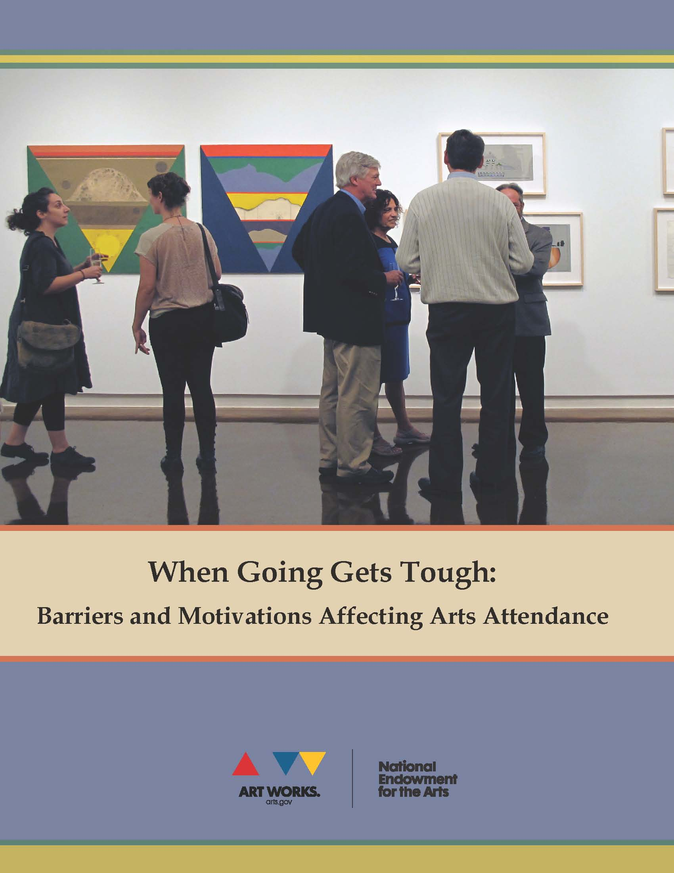
General Social Survey: NEA Arts Module
18

Slide 19
Percent of U.S. Adults Who Attended the Visual and/or Performing Arts in the Past 12 Months, by Event Type (2012)
19

Slide 20
Top Motivations for Attending Visual and/or Performing Arts Events by Percent of U.S. Adults Who Reported Them (2012)
20

Slide 21
Percent Who Attended in the Past 12 Months, by Most Recent Event and Motivations for Doing So (2012)
21

Slide 22
Percent Who Attended the Arts in the Past 12 Months, by Most Recent Event and by Who (If Anyone) Accompanied Them (2012)
22

Slide 23
Percent Who Were Interested in, but Did Not Attend, the Arts in the Past 12 Months, by Most Recent Event They Wanted to Attend (2012)
13% (31 mil. adults) wanted to attend either a visual or performing arts event but chose not to
23

Slide 24
Top Barriers to Attending Visual and/or Performing Arts Events, by Percent of U.S. Adults Who Reported Them (2012)

Slide 25
Percent Who Were Interested in, but Did Not Attend, the Arts in the Past 12 Months, by Most Recent Event They Wanted to Attend (2012)

Slide 26
Percent of U.S. Adults Who “Agree” or “Strongly Agree” with Value Statements Significant in Predicting Arts Attendance (2012)
26

Slide 27
Additional Resources
Arts Data Profile #4 – Why Don’t They Come? Characteristics of Interested Non-Attendees of the Arts
Questionnaire, data files
27

Slide 28
U.S. Arts and Cultural Production Satellite Account
28

Slide 29
Arts and Cultural Production as Part of U.S. GDP: 1998-2012
Value added to GDP in 2012: $698 B, or 4.32%
29

Slide 30
Value Added to U.S. GDP by Sector, 2012 (in billions)
30

Slide 31
Imports and Exports of Arts and Cultural Goods and Services: 1998-2012
31

Slide 32
32

Slide 33
33

Slide 34
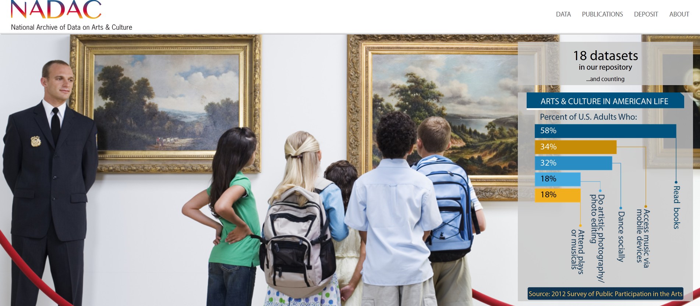
National Archive of Data on Arts & Culture
34

Slide 35
Q&A

Slide 36
Questions?
Contacts:
Laura Scanlan – scanlanl@arts.gov
Sunil Iyengar – iyengars@arts.gov

